Slide 1
Digital waste
Presented by:
Meggouri Ismail
Ange Guillaume KOFFI

Slide 2

PLAN
What is digital waste
Types of digital wastes
How these become wastes ?
Repercussions on environment
Repercussions on human body
Statistics for impact measurement
Solutions for Reducing Digital Waste
Countries Generate the Most Electronic Waste
Mapping Out E-Waste
Summary

Slide 3
DIGITAL WASTE
1. What is it ?

Slide 4
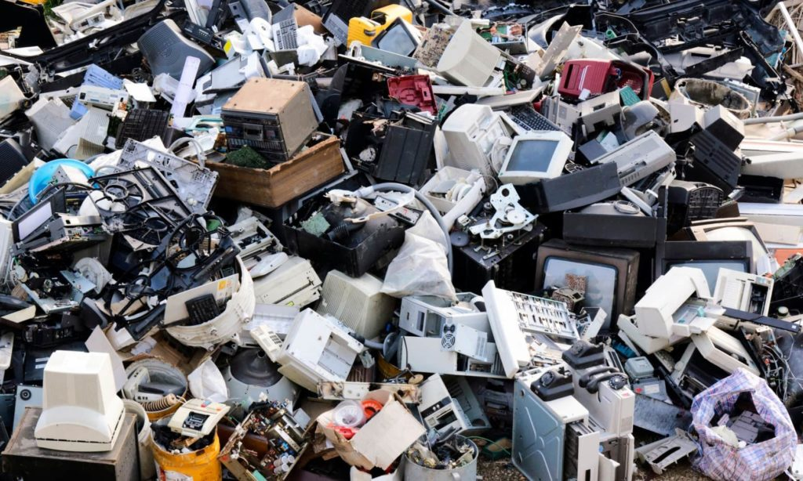
Definition
Digital waste, also known as electronic waste or e-waste, refers to discarded or outdated electronic devices and equipment. This can include items such as computers, smartphones, televisions, and other consumer electronics.

Slide 5
DIGITAL WASTE
2. what are the types ?

Slide 6
Types of Digital wastes
Laptop
Digital waste
Mobile phones
Keyboards and computer mouse
Vending machines
Scanners, printers and copiers
Consumer electronic devices and solar panels.
Audio-video equipment's

Slide 7
DIGITAL WASTE
3. How these become wastes ?

Slide 8

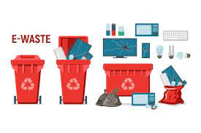
The reasons
Advancement in technology
Changes in style fashion and status
Nearing the end of their useful life
Not taking precautions while handling them

Slide 9
DIGITAL WASTE
4. what are the repercussions on environment ?

Slide 10

Repercussions on environment
Pollution
Digital waste can release toxic chemicals into the air and water when it is not properly disposed of. This can lead to pollution of the air and water, which can harm both wildlife and human populations.
Loss of biodiversity
Digital waste disposal can have a negative impact on the environment, particularly in developing countries where it is often not properly regulated. This can lead to the destruction of natural habitats and the loss of biodiversity.
Digital waste disposal contributes to greenhouse gas emissions through the release of methane and other gases from landfills and through the energy used in the manufacturing process.
Climate Change
Resource depletion
Many electronic devices are made from scarce resources such as rare metals, which are mined and processed at a high environmental cost. As e-waste increases, so does the depletion of these resources.

Slide 11
DIGITAL WASTE
5. what are the repercussions on human body ?

Slide 12
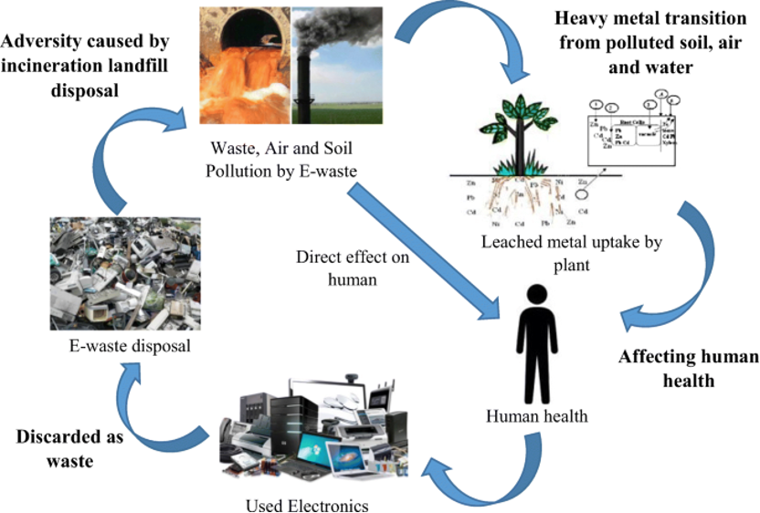
Repercussions on human body
Exposure to toxic chemicals
E-waste often contains toxic chemicals such as lead, mercury, and cadmium, which can harm human health when not properly disposed of. Cause neurological damage, respiratory problems, and other health issues.
Air pollution
The burning of e-waste to recover valuable materials can release toxic chemicals into the air, which can be inhaled by people living near e-waste disposal sites.
E-waste can also contaminate water supplies, which can lead to health problems such as diarrhea, kidney damage, and cancer.
Water pollution
Noise pollution
Occupational hazards
The process of recovering valuable materials from e-waste can be a noisy process, which can lead to hearing loss and other health problems for people living near e-waste disposal sites.
People working in e-waste recycling facilities are at risk of exposure to toxic chemicals, as well as other hazards such as noise and heavy machinery.

Slide 13
DIGITAL WASTE
6. what are statistics ?

Slide 14
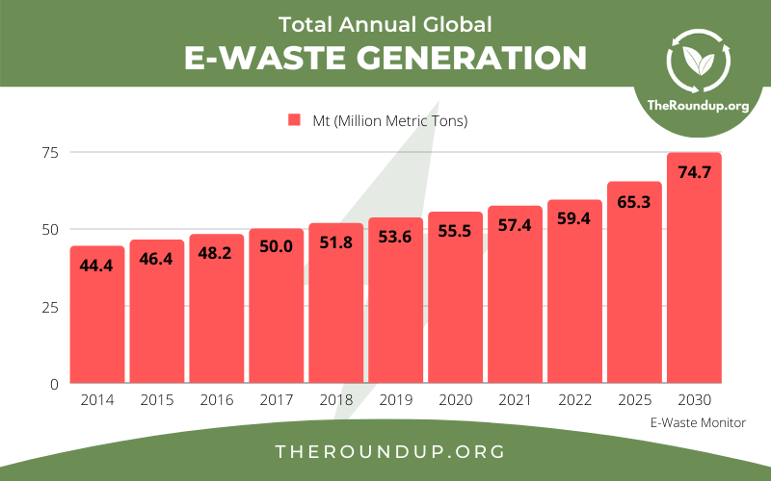
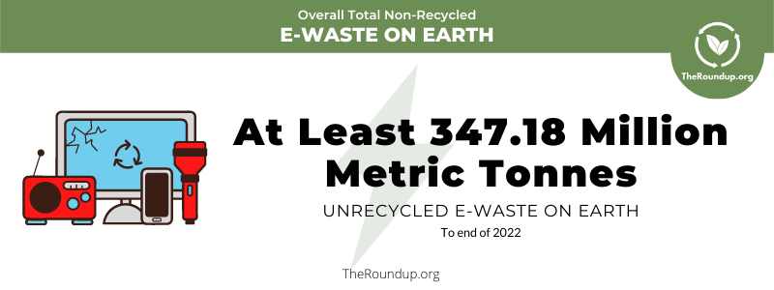
Digital waste produced each Year
It is estimated that 57.4 Mt (Million Metric Tons) of e-waste was generated globally in 2021.
There has been an increase year on year since e-waste data started being collected in 2014.

Slide 15
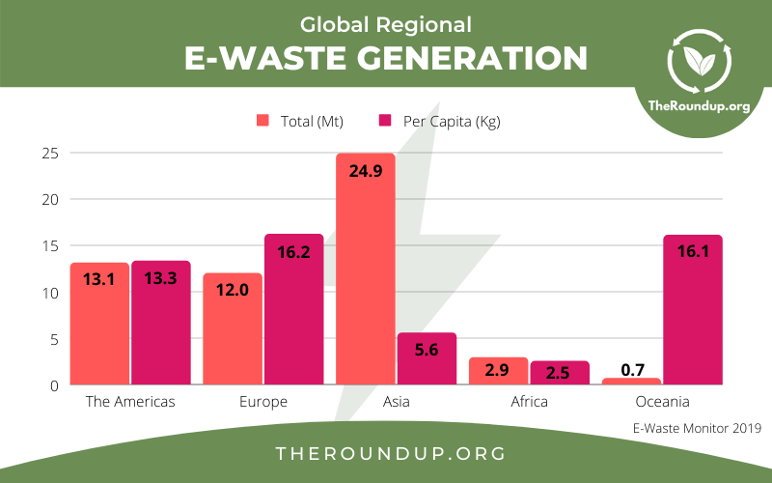
The Region that Produces the Most E-Waste by Volume

Slide 16
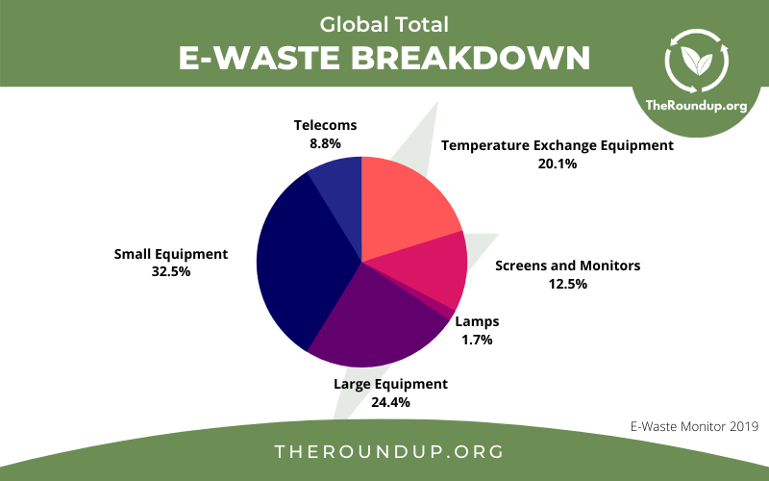
The Region that Produces the Most E-Waste by Volume

Slide 17
DIGITAL WASTE
7. what solutions to reduce digital waste ?

Slide 18
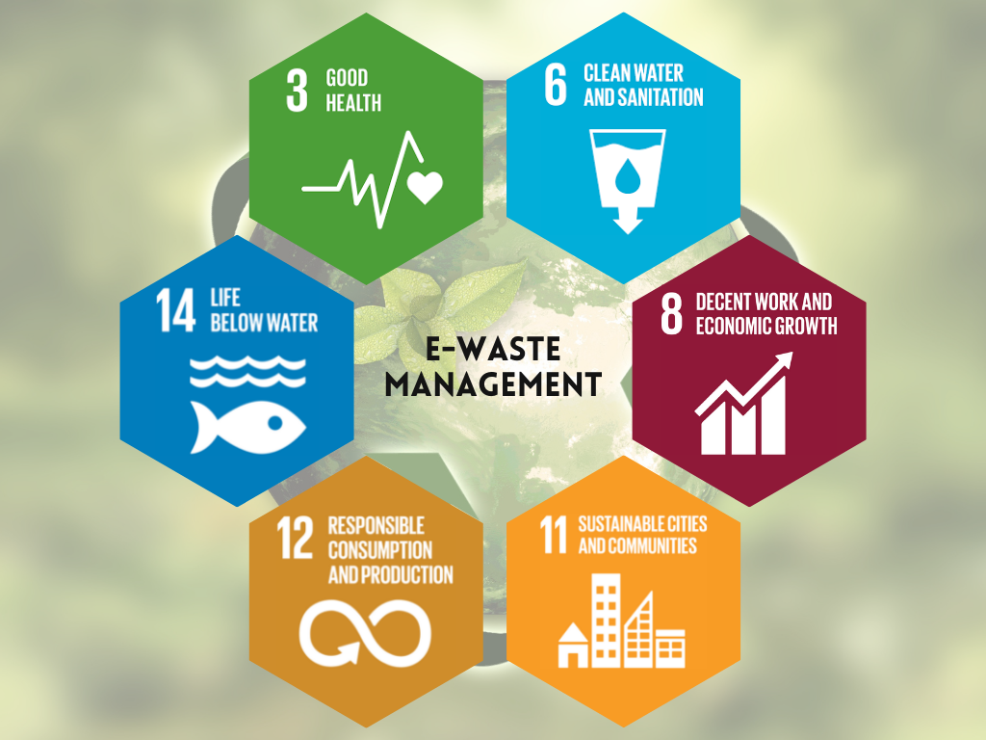
Solutions for Reducing
Recycling
Electronic devices can be recycled through certified e-waste management companies. This can recover valuable materials such as metals, plastics, and glass, and reduce the environmental impact of digital waste.
Erase data
Before disposing of electronic devices, individuals and organizations should ensure that all data and software stored on the device is properly erased or disposed of to protect personal and sensitive information.
Public awareness
Raising public awareness about the environmental and security risks of e-waste can encourage individuals and organizations to take steps to reduce digital waste and properly dispose of their electronic devices.
Government regulations
Governments can play a key role in reducing e-waste by implementing regulations and policies that encourage digital waste reduction, recycling, and proper disposal.

Slide 19
DIGITAL WASTE
8. Countries Generate the Most Electronic Waste.

Slide 20
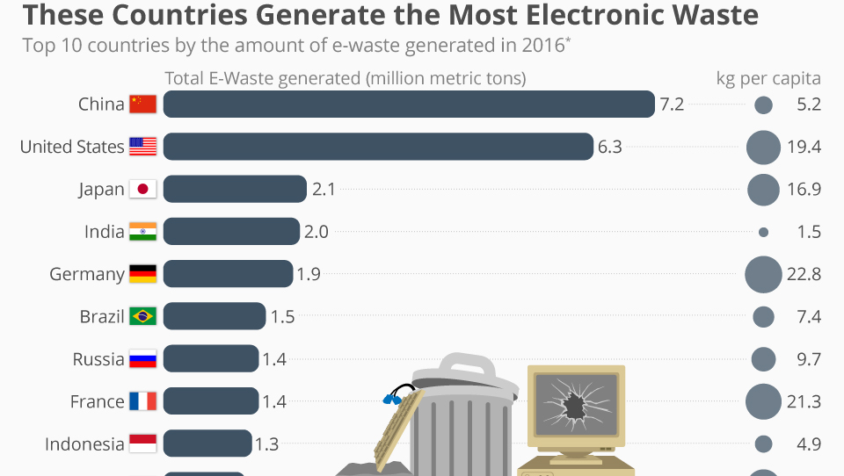

Slide 21
DIGITAL WASTE
9. Mapping Out E-Waste.

Slide 22
Countries most receiving E-waste
Countries such as China, India, Pakistan, Vietnam, and Ghana are among the top destinations for e-waste imports. These countries lack the proper infrastructure and regulations to handle e-waste safely and responsibly, and as a result, e-waste is often processed in informal and unsafe ways, causing harm to the environment and human health. It's important to note that the informal and illegal e-waste trade is not just a problem in developing countries, it is a worldwide problem.

Slide 23
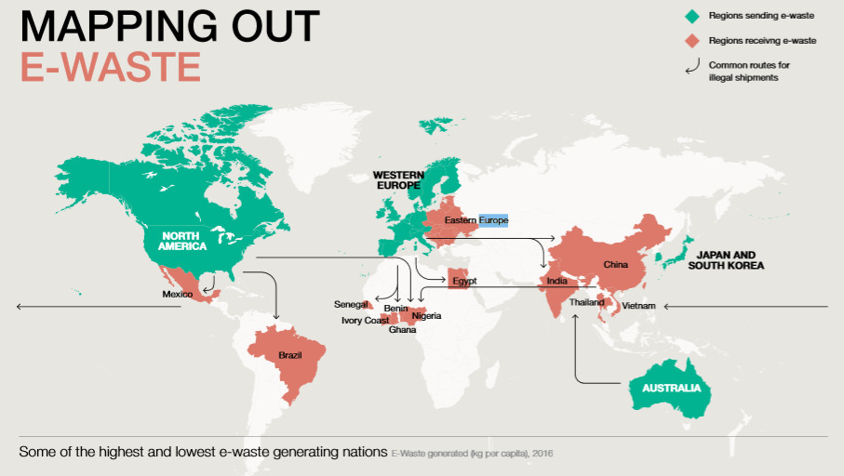

Slide 24



Summary

Slide 25




Thank you
Meggouri Ismail
Ange Guillaume KOFFI

Slide 26
Questions
&
Suggestions
Are welcome

